Slide 1
LOOPS

Slide 2



Lecture Outline

Slide 3

Loop
A loop can be used to tell a program to execute statements repeatedly
Suppose that you need to display a string (e.g., "Welcome to C++!") 100 times.
So how to solve this problem???

Slide 4
While Loop
C++ provides a powerful construct called a loop that controls how many times an operation or a sequence of operations is performed in succession. Using a loop statement, you simply tell the computer to display a string 100 times without having to code the print statement 100 times, as follows:
int count = 0;
while (count < 100)
{
cout << "Welcome to C++!\n"; count++;
}
Note: The braces enclosing the loop body can be omitted only if the loop body contains one statement or none.

Slide 5
While Loop
The variable count is initially 0. The loop checks whether (count < 100) is true. If so, it executes the loop body to display the message Welcome to C++! and increments count by 1. It repeatedly executes the loop body until (count < 100) becomes false (i.e., when count reaches 100). At this point, the loop terminates and the next statement after the loop statement is executed
Loops are constructs that control repeated executions of a block of statements. The concept of looping is fundamental to programming. C++ provides three types of loop statements: while loops, do-while loops, and for loops.

Slide 6
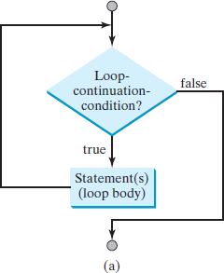
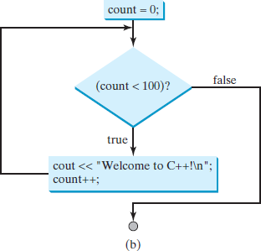
Flow Chart for while Loop

Slide 7
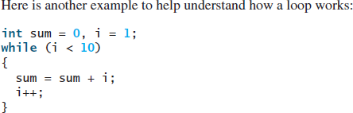
While loop
If i < 10 is true, the program adds i to sum. Variable i is initially set to 1, then is incremented
to 2, 3, and up to 10. When i is 10, i < 10 is false, so the loop exits. Therefore,
the sum is 1 + 2 + 3 + ... + 9 = 45.

Slide 8
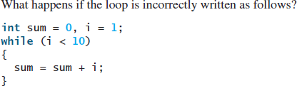
Identify the problem?

Slide 9
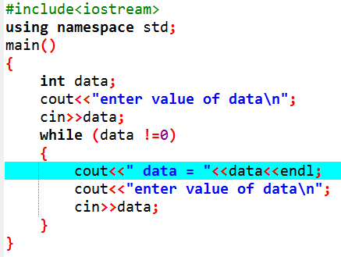
Controlling a Loop with a Sentinel Value
Another common technique for controlling a loop is to designate a special value when reading and processing a set of values. This special input value, known as a sentinel value, signifies the end of the input. A loop that uses a sentinel value to control its execution is called a sentinel-controlled loop.
Run

Slide 10
For loop
A for loop has a concise syntax for writing loops.
A for loop can be used to simplify the above loop:
for (i = initialValue; i < endValue; i++)
{
// Loop body
...
}
The flowchart of the for loop is shown in Figure

Slide 11
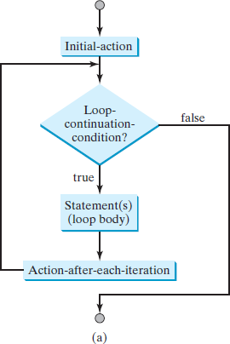
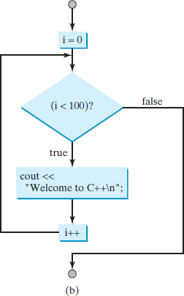
Flow chart for loop
1
A for loop performs an initial action once, then repeatedly executes the statements in the loop body, and performs an action after an iteration when the loop-continuation-condition evaluates to true.

Slide 12
For Loop
The loop control variable can be declared and initialized in the for loop. Here is an example:
for (int i = 0; i < 100; i++)
{
cout << "Welcome to C++!\n";
}
If there is only one statement in the loop body, as in this example, the braces can be omitted as shown below:
for (int i = 0; i < 100; i++)
cout << "Welcome to C++!\n";
Question: What are the three parts of a for loop control?

Slide 13
The do-while Loop
A do-while loop is the same as a while loop except that it executes the loop body first and then checks the loop continuation condition.
The do-while loop is a variation of the while loop. Its syntax is as follows:
do
{
// Loop body; Statement(s);
}
while (loop-continuation-condition);

Slide 14
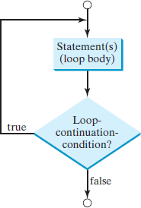
Do while loop
Flow Chart
The do-while loop executes the loop body first, then checks the loop-continuation-condition to determine whether to continue or terminate the loop.

Slide 15
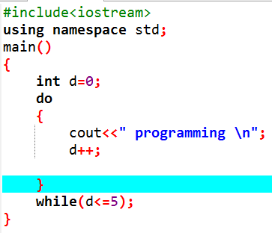
Do while loop
Run this program and differentiate between while and do while loop

Slide 16
Important: Which Loop to Use?
You can use a for loop, a while loop, or a do-while loop, whichever is convenient.
In general, a for loop may be used if the number of repetitions is known in advance, as, for example, when you need to display message 100 times.
A while loop may be used if the number of repetitions is not fixed, as in the case of reading the numbers until the input is 0.

Slide 17
Task 2:
Write a c++ code using for loop which print values from 1 to 5 using for loop
Write a c++ code using for loop which print table of 2 using for loop

Slide 18
Task 2:
1. Print values from 1 to 5 using for loop
#include <iostream>
using namespace std;
int main()
{
for (int i = 1; i <= 5; i++)
{
cout << i << " ";
}
return 0;
}

Slide 19
Task 2:
2. Print Table of 2 using for loop
#include <iostream>
using namespace std;
int main()
{
for (int i = 1; i <= 10; i++)
{
cout << "2 x " << i << " = " << 2 * i << endl;
}
return 0;
}
;
}

Slide 20
Task 1:
Write a c++ code using while loop which print values from 1 to 5 using while loop
Write a c++ code using while loop which print table of 2 using while loop

Slide 21
Task 2:
1. Print values from 1 to 5 (using while loop)
#include <iostream>
using namespace std;
int main()
{
int i = 1;
while (i <= 5)
{
cout << i << " ";
i++;
}
return 0;
}

Slide 22
Task 2:
2. Print Table of 2 (using while loop)
#include <iostream>
using namespace std;
int main()
{
int i = 1;
while (i <= 10)
{
cout << "2 x " << i << " = " << 2 * i << endl;
i++;
}
return 0;
}

Slide 23
Next Lecture
Nested loop

